Slide 1
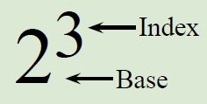
24
7
30
Index Notation
Date
EQ – What are the rules for index notation?
A convenient way of writing 2 x 2 x 2 is
When we multiply a number by itself, we usually use a more concise notation. For example:
3 = 3¹ | (read as '3' or '3 to the power 1')
3 × 3 = 3² | (read as '3 squared')
3 × 3 × 3 = 3³ | (read as '3 cubed')
3 × 3 × 3 × 3 = 3⁴ | (read as '3 to the power 4' or as '3 to the 4th')
3 × 3 × 3 × 3 × 3 = 3⁵ | (read as '3 to the power 5' or as '3 to the 5')
3 × 3 × 3 × 3 × 3 × 3 = 3⁶ | (read as '3 to the power 6' or as '3 to the 6')

Slide 2
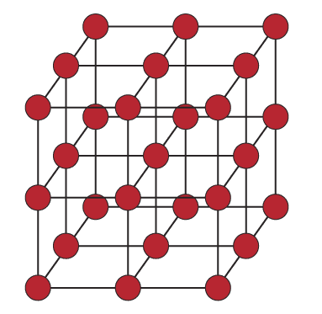

24
7
30
Index Notation
Date
EQ – What are the rules for index notation?
The terms '3 squared' for 3² and '3 cubed' for 3³ come from geometry.
You might have seen before we can arrange 3² dots in a square and 3³ dots in a cube:
Notes:
Note, no easy representation of higher powers.

Slide 3
24
7
30
Index Notation
Date
EQ – What are the rules for index notation?
Example 1: Calculate 6²
6² means 6 x 6
=
36
Example 2: Evaluate 2⁵
2⁵ means 2 x 2 x 2 x 2 x 2
=
32
Example 3: Find 9⁴
9⁴ means 9 x 9 x 9 x 9
=
6561
Notes:
Point out calculate, evaluate as language = give me a number!

Slide 4
24
7
30
Index Notation
Date
EQ – What are the rules for index notation?
Example 4: Write a² in factor form
a² means a x a
Example 5: Write b⁵ in factor form
b⁵ means b x b x b x b x b
Example 6: Write f⁴g³ in factor form
f⁴g³ means f x f x f x f x g x g x g
Notes:
For example 6 remind the class to use alphabetical order for variables.

Slide 5
24
7
30
Index Notation
Date
EQ – What are the rules for index notation?
Example 7: Write k x k in index form
k x k means k²
Example 8: Write m x m x n x n x n in index form
m x m x n x n x n means m²n³
Example 9: Write 3gg3ggg3 in index form
3gg3ggg3 means 3³g⁵
Notes:
Alphabetical order again for variables.

Slide 6
24
7
30
Index Notation
Date
EQ – What are the rules for index notation?
What is the largest prime number ever found?
2^{77,232,917} − 1
This number is 23 429 425 digits long
In partners one of you is to write out the digits 0 to 9
(i.e. 0123456789) while the other one records the time it takes them.
Next use this result to calculate how long it would take you to write out all 23 million digits in this number.
It’s much easier to write it out in index form isn’t it!
Notes:
They will need either a watch with a seconds indication, or their smartphones.

Slide 7
Example 7: Write k x k in index form
Example 7: Write k x k in index form
k x k means k²
k x k means k²
Example 8: Write m x m x n x n x n in index form
Example 8: Write m x m x n x n x n in index form
m x m x n x n x n means m²n³
m x m x n x n x n means m²n³
Example 9: Write 3gg3ggg3 in index form
Example 9: Write 3gg3ggg3 in index form
3gg3ggg3 means 3³g⁵
3gg3ggg3 means 3³g⁵
Use the above to help you work through exercise 1.2, 1.3 and 1.4 in the textbook, page 3
Notes:
Dwyer book

